Slide 1
Manegment System
Moon Light
Decoration Center
Under Supervision of:-
Dr. Hatem El Boghdady
Made By:-
Rasha Eskander
Suzan sobehy
Dina Romany
Yostina aziz
Nancy makram
Monda maged

Slide 2
:- System Request
1. Project Name:
· Moonlight manegent system
2. Project Sponsor:
. Mr. Shreen alfy
3. Business Need:
· Monitor business evolution in order to simplify management by giving the manager wider control for his business.
4. Functionality:
· System will provide users with:
§ Supplier account.
§ Client account.
§ Store management.
§ Employee management.

Slide 3
System request (cont):-
Moon light decoration center manger has requested a computer system for organizing work such that suppliers ,clients ,store ,employee
The project is a database consists of a four tables :
***Supplier.
***Client.
***Store.
***Employee.

Slide 4
Project Abstract
The project mainly is a database. This database will keep all the customers and supplier information. It also will provide us with product 's information. In order to help the manager organizing his business. It also will give him a general view of the employers’ performance; as well as a general view of his hall business performance. This view is held out through some statistics ; and make the sales accounts.
Through the system the manager will be able to know information about the supplier and customer who dealing with him also the products in his store. This will lead to a general progress in the business performance.

Slide 5
Expected Value:
****Tangible Value:
§ Sales will increase by 1000 LE per month.
****Intangible Value:
§ Improved customers satisfaction.
§ He also will be able to know the weak points in his business.
§ He will be able to trace his deals with customers and supplier.
**** Special Issue in constrains:
· Interviews can only be done twice a week (On Monday &Thursday).
· The system should be delivered before 17/5/2006

Slide 6
Feasibility Analysis
Technical feasibility
Familiarity with application (low)
· The stakeholder in organization have little skills in using computer.
· The team work of project have little experience with application area.
Familiarity with technology(Moderate)
· The organization was using manual system.
· The employees are not familiar with the new technology.
· The team work are familiar with C# technology to implement the project.
Technical feasibility
Technical feasibility
Technical feasibility
Technical feasibility
Technical feasibility
Technical feasibility
Technical feasibility

Slide 7
Technical feasibility Cont.
Project size(Moderate)
· Their are two stakeholder will use the system .
· With some effort, we can design a system to reduce complexity and mistakes
· The project will take four week to complete system implementation

Slide 8
* Economic feasibility(excellent)
Tangible cost and benefit::-
· 78.74% ROI overa3year period.
· Total benefits after 3 years equal 10,200.
Intangible cost and benefits:
· Employee satisfaction leads to accurate results.
· Reduce the mistakes in calculating.
Organizational feasibility :( excellent)
Users:
· The employees in Salaries department.
· The manager

Slide 9
Work Plan
Deliverables
Estimated Hours
Assigned To
Planning
Identify Business Value
System Request
5
Sponsor
Feasibility Analysis
Perform Technical Feasibility
Perform Economic Feasibility
Perform Organizational Feasibility
Feasibility Analysis
Cost-benefits analysis
Stakeholder analysis
6
10
4
Sponsor
Sponsor
Sponsor
Sponsor
Project Management
Create Work Plan
Staff The Project
Prepare Documentation
Work Plan
Staffing Plan
4
2
2
Team Work
Team Work
Team Work
Analysis
Logical data,process model
Physicaldata,process model
10
Team Work
and Implementation
Design
Sponsor
Implementation
3 weeks

Slide 10
Interviews Report:-
***The first interview made with mr/shereen alfi the maneger TO know general requirment
***The second interview made with mr/shenoda the accountant TO know account system problems
***The third interview made with mr/shenoda the accountant TO understand the old manual system

Slide 11
Analysis Plan :-
We use business process automation
1- Understand the As-Is System:-
*Interviews
2- Identifying Improvements:-
*we use problem analysis
3- Developing a To-Be system concept

Slide 12
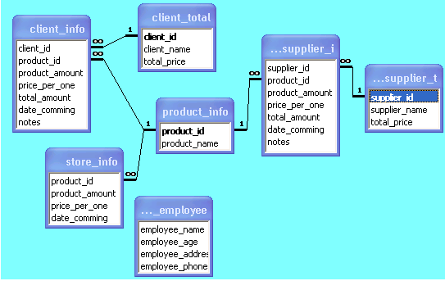
Logical data model

